Slide 1

INTRODUCTION
TO
MEDICAL PARASITOLOGY

Slide 2
OUTLINE
  Definition of terms
  Scope of medical parasitology
  Concepts related to medical parasitology
  Epidemiology of parasites.
  General life cycle of parasites
  Parasitic diseases
  Host immunity & immuno – evasion of parasites
  Nomenclature and classification of parasites

Slide 3
Specific Learning Objectives
At the end of this chapter the student will be able to:
  Define common terms used in medical parasitology
  Describe Scope of Human parasitology
  Explain host-parasite relationship
  Discuss the geographical distribution, mode of transmission, source of infection, and portal of entry of parasites
  Explain the general life cycles of parasites
  Discuss the general pathogenesis of parasites
  Explain briefly host immunity & immuno – evasion mechanisms by parasites
  Describe classification of medically important parasites

Slide 4
Introduction to Medical parasitology
1.1. Definition
Medical parasitology (GK: para = beside
Sitos = food
  The study of the parasites of man and their medical consequences .
It is a subject that researches:
  the biological features of human parasites,
  the relationship between the human being and the parasites,
  the prevention and treatment of the parasitic diseases.

Slide 5
1.2. Scope of Medical Parasitology
According to the very broad definition of parasitology, parasites should include:-
    viruses, bacteria, fungi,
    protozoa and metazoa (multi-celled organisms) which infect their host species.
  However, for historical reasons the first three have been incorporated into the discipline of Microbiology.

Slide 6
Cont…
Therefore, Medical parasitology consists of:-
    Protozoa (single celled animals),
    Helminths (worms)
    Arthropods

Slide 7
Phylum Sarcomastigophora
    Amoeba
    Flagellates
Phylum Apicomplexa
Phylum Microsporodia
Phylum Ciliophora
Medical
Protozoology
Human Parasitology
Class Nematoda
Class Trematoda
Class Cestoda
Class Metacanthocephala
Medical
Helminthology
Class Insecta
Class Arachnida
Class Crustacea
Class Chilopoda
Medical
Arthropodology

Slide 8
The importance of parasitology
Six major tropical diseases to which WHO pays great attention include:
    malaria,
    schistosomiasis,
    filariasis,
    leishmaniasis,
    trypanosomiasis and
    leprosy.
Five of them are parasitic diseases except leprosy.
All the above diseases are prevalent in Ethiopia

Slide 9
Why were they selected?
Schistosomiasis - 200,000,000 infected
500,000-1,000,000 deaths/year
Malaria - 500,000,000 infected
2,500,000 deaths/year
Filariasis - 250,000,000 infected
Trypanosomiasis - 25,000,000 infected
65,000 deaths/year
Leishmaniasis - 1,200,000 infected

Slide 10
1.3. Concepts related to medical parasitology
1.3.1. Symbiosis
Any association more or less permanent is called a symbiosis, with each member a symbiont.
Two different organisms live together and interact,
one partner lives in or on another one’s body.
  3 types:
    Mutualism
    Commensalism
    Parasitism

Slide 11
Mutualism
  Permanent association between two different organisms that life apart is impossible,
  Two partners benefit each other,
  The mutuals are metabolically dependent on one another;
  One cannot survive in the absence of the other.
  e.g. Certain flagellates and termite

Slide 12
Commensalism
  Association of two different organisms
  One partner is benefited while the other neither benefited nor injured, such as E. Coli and man.
Parasitism
  Association of two different organisms
  One partner is benefited while the other is injured, such as ascaris lumbricoides and man.

Slide 13
1.3.1. Parasite and types of parasites
Parasite:-
In parasitism, parasite is the benefited partner.
It is an animal organism which lives in or on the host in order to obtain nourishment and shelter from the host as well as does harms to the host.

Slide 14
In another words
  A small organism (Parasite) has the potential to harm a larger organism (Host), and relies on said host for nutrients and shelter (a Niche).
  The parasite generally has a much higher reproductive capability compared to its host.

Slide 15
Types of Parasites
Parasite can be Classified
I. According to their habitat
  Endoparasite
    Lives inside the body of the host
    May be just under the surface or deep in the body
      Tapeworms, flukes, protozoans
  Ectoparasite
    Stays on outside surface of the host
      leeches, ticks, fleas, brood parasites

Slide 16
II. Based on dependency on the host
Obligate Parasite
  Requires finding and invading the host to complete its life cycle
  Most of the parasites we will cover are obligate parasites
Facultative Parasite
  May become parasitic if it is given the chance but does not require a host.

Slide 17
-
III. Amount of time spent
Permanent Parasite
  Lives entire adult life stage on or in a host
  Usually endoparasites
    One exception is eyelash mite
Temporary Parasite
  Spends only a short time on a host
  Usually ectoparasites

Slide 18
III. According to their Pathogenicity:
  Pathogenic parasites
  Non-Pathogenic (commensal)
  Opportunistic parasites

Slide 19
IV. Based on their life cycle
Monoxenous parasites:
  Those with direct life cycles (i.e., with one host).
Heteroxenous parasites:
  Those with inderect life cycles requiring an intermediate host (i.e., involves 2 or more hosts).
Heterogenetic Parasites:
  One with alteration of generations e.g., Coccidial parasites and Strongyloides

Slide 20
V. Based on host ranges
Euryxenous parasites:
  Those with a broad host range.
Stenoxenous parasites:
  Those with a narrow host range;

Slide 21
Other terminology
Aberrant parasite:
  Found in locations in the host where they normally do not occur;
  e.g., Ascaris larvae may migrate to the brain
Insidental parasite:
  Occurs in hosts where it does not normally occur;
  e.g., Fasciola normally does not occur in man but is incidental if found in man’s liver.

Slide 22
1.3.3. Hosts and types of hosts
Host:-Hosts are organism which harbors the
parasite.
      In parasitism, it is the injured partner
Types of Hosts: -
  Definitive host:-
  Intermediate host:-

Slide 23
Definitive host:-
  What characterizes the primary host?
    Where sexual reproduction takes place.
    Normally where the adult parasites live.
    Normally the larger of the hosts, usually a vertebrate.
    Convention - (parasites which only reproduce asexually)
    Specificity - frequently, a large number of host species can act as intermediate host and only one or a few can act as a definitive host

Slide 24
Intermediate host:-
      sexually immature or larval stage of a parasite
      Asexual multiplication takes place
      may harbor many immature stages of a parasite;
      e.g., Cercaria, Redia and Sporocysts which are all immature stages of Fasciola in the snail intermediate host.
    Some parasites:
      require more than one intermediate host which are then designated as first, second intermediate,

Slide 25
Other terminology
Paratenic or Transport Host
  No development occurs but parasite remains alive and infective to another host
  May go dormant
  May cause damage
  e.g., Toxoplasm species in cattle
Accidental or Incidental Host
  Parasite is in the “wrong” species.
  Parasite usually wanders around and causes great damage because it doesn’t know where to go then dies.

Slide 26
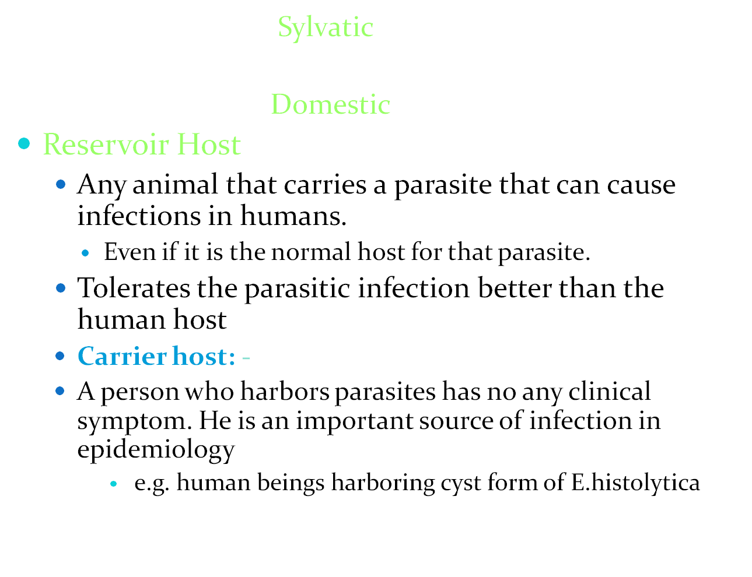
Types of Hosts

Slide 27
1.3.4. Host specificity
The number of species the parasite can use as a definitive or intermediate host.
determined by genetic, immunological, physiological, and/or ecological factors.
Parasites show varying degrees of host specificity
  A few parasites will infect only one species
  Most parasites will infect a few closely related species (or similar anatomy)
  Some parasites can infect a large group of animals
  A few parasites have little or no host specificity

Slide 28
1.3.5. Vector and types of vectors
Vector:-an organism (usually an arthropod) which transfers
infective forms of a parasite from one host to the
other.
Classification
    1. Biological vectors:-
    2. Mechanical (Parathenic or transport) Vectors:

Slide 29
  Biological vectors:-
  characterized by the development of the
  parasite before its transfer to another host
      Propagative.
        E.g. Yersinia pestis in fleas
      Cyclopropagative
        E.g. Plasmodium vivax in Anopheles mosquitoes.

Slide 30
      Cyclodevelopmental
        E.g.Onchocerca volvulus in black flies.
2. Mechanical vector
      no parasitic development of reproduction occurs

Slide 31
1.3.6. Other terminologies
*Infective Stage : it is a stage when a parasite can invade human body and continue to live there. The infective stage of ascarid is the embryonate egg.
*Infective Route is the specific entrance through which the parasite invades the human body. Hookworms invade human body by skin. Man gets infection with ascarid by mouth.
Infective Mode means how the parasite invades human body, such as the cercariae of the blood fluke actively penetrate the skin of a swimming man and the infective ascaris eggs are swallowed by man.

Slide 32
Geohelminth
  refers to the helminths which complete their life cycles not requiring the processes of the development in intermediate hosts.
  They have only one host and a simple life cycle, such as ascarid, hookworm, pinworm and etc.
Biohelminth
  refers to the helminths which have to undergo the development in intermediate hosts to complete their life cycles, such as filaria, liver fluke, pork tapeworm and so on.

Slide 33
Alternation of Generation:
  In life cycles of some parasites, there is the regular alternation of sexual and asexual reproductions, eg.Plasmodium vivax

Slide 34
*Trophozoite is a living stage of protozoa when they can move, take food and reproduce. (It is usually the pathogenic stage.)
*Cyst is the resting stage of a protozoa with a protective wall. It is usually the infective stage. Its functions are protection, transmission and multiplication.
Encystation
Trophozoite Cyst
Excystation

Slide 35
1.4. Epidemiology of parasite
Epidimology: The study of the patterns of diseases within populations
For parasites, this includes:
    Host range – what can it infect?
    Geographic range – where is it?
    Is it a zoonotic agent?
      Can it infect humans?
    Does it have a reservoir?
      A group of vertebrates maintaining the parasite
    Does it have a nidus?
      A small ecosystem that possesses all the factors to maintain the parasite..

Slide 36
1.4.1. Geographic Distribution
Global distribution
  parasite occur globally,
  the majority occur in tropical regions,
  Factors
    Favorable environmental conditions
    poverty, poor sanitation and personal hygiene

Slide 37
Epidemiology…
parasitic diseases are more prevalent in the tropics and subtropics.
FACTORS INFLUENCING PREVALENCE
  unsanitary living conditions,
  inadequate funding for disease control and treatment
  poor nutrition
  lack of health education (although this is improving)
  regional and ethnic customs conducive to infection by parasites
  climatic conditions and
  compromised immune systems

Slide 38
The burden of some major parasitic infections
Parasite | Diseases | No. people infected | Deaths/yr
Plasmodium | malaria | 273 million | 1.12 million
Soil transmitted helminths: Roundworm (Ascaris) Whipworm (Trichuris) Hookworm (Ancylostoma and Necator) | Pnemonitis, intestinal obstruction Bloody diarrhoea, rectal prolapse Coughing, wheezing, abdominal pain and anaemia | 2 billion | 200,000
Schistosoma | Renal tract and intestinal disease | 200 million | 15,000
Filariae | Lymphatic filariasis and elephantiasis | 120 million | Not fatal but 40 million disfigured or incapacitated
Trypanasoma cruzi | Chagas disease (cardiovascular) | 13 million | 14,000
African trypanosomes | African sleeping sickness | 0.3 – 0.5 million | 48,000
Leishamania | Cutaneous, mucocutaneous and visceral leishmaniasis | 12 million; 2 million new cases/yr | 50,000

Slide 39
Factors (Endemicity):
Presence of a suitable host
Habits of the host
Escape from the host
Favorable conditions outside of host
Economic and social conditions

Slide 40
1.4.2. Transmission of parasites
Factors required:(Three key links of parasitic disease transmission)
1. Source of infection
2. Mode of transmission
3. Susceptible people

Slide 41
1.4.2.1. source of exposure
1. primary Source
  infected persons
  carriers
  animals

Slide 42
1. Sources of Exposure to Parasitic Infections
  Contaminated soil:-
      Soils polluted with human excreta is commonly responsible for exposure to infection with geohelminthes

Slide 43
Contaminated water:-
Water may contain
    (a) viable cysts of Amoeba, flagellates etc,
    (b) cercarial stages of human blood fluke,
    (c) Cyclops containing larva of Dracunculus medinensis
    (d) fresh water fishes which are sources for fish tape
    worm, and intestinal flukes infection
    (e) crab or cray fishes that are sources for lung fluke and
    (f ) Water plants which are sources for Fasciolopsis buski.

Slide 44
C. Raw or Insufficiently cooked meat of pork, beef and fish
      E.g., Trichinella spiralis, Taenia species, D.latum.
Blood sucking arthropods:
    Malaria - anopheles mosquito,
    Leishmania - sand flies
    Trypanosoma - tsetse flyb
E. Animals (a domestic or wild animals harboring the parasite),
    e.g, 1. Dogs- the hydatid cyst caused by E. granulosus

Slide 45
F. Human beings:-
    A person his/her clothing, bedding or the immediate environment that he/she contaminated
  Autoinfection: - e.g., S. stercoralis, E. vermicularis, and T. solium

Slide 46
1.4.2.2. Mode of Transmission
Direct mode of Transmission:-
classified as:
I.Horizontal Direct mode of transmission: Transmission is mainly effected through:-
  Feco-oral route: most intestinal parasites transmitted in this way.
  Sexual intercourse
  Blood transfusion
  Direct skin penetration

Slide 47
II. Vertical Direct Mode of Transmission:
Transmission of the parasite is from the
mother to child through:
Congenital / transplacental
Transmammary (breast milk

Slide 48
II- Indirect Mode of Transmission:-
  If the parasite
      has complex life cycle
      requires biological vectors and/or
      one or more intermediate hosts

Slide 49
Route of Transmission
  I. By ingesting infective stage of parasites:
    In food, water or hands contaminated with faeces,
      E.g. E. histolytica, E. vermicularis, etc.
    In raw or undercooked meat, e.g. T. saginata, T. solium, T. spiralis
    In raw or undercooked fish, crab, or water vegetation e.g. intestinal flukes
    Water containing Cyclope e.g., D. medinensis

Slide 50
II. Penetration of Skin When in Contact with:
  Faecally polluted soil, e.g., S.stercoralis, Hook worms
  Water containing infective stages of the parasite E.g., Cercaria of Schistosome species .
III. Through Insect Bite,
  E.g., filarial worms, Trypanosoma sp, Plasmodium sp. etc.

Slide 51
Sexual Contact, e.g., Trichomonas vaginalis
Transmammary, e.g., S. stercoralis
Inhalation of contaminated air, e.g., E. vermicularis, P. carnii
Transplacental, e.g., T. gondii
Kissing, e.g., Trichomonas gingivalis, T. tenax

Slide 52
1.5 General Life Cycles of parasites
Describes the cycle of development of the parasite,
This may involve
    Passing through a number of developmental stages & enviroment
    Parasitic and non-parasitic stages.
The life of a parasite can be divided into a number of phases:
  Growth and maturation,
  Reproductive (sexual and asexual) and
  Transmission phases.
  All vitally important for the successful survival of the parasite.
Can be simple or complex depending on how many different hosts it requires to complete its cycle

Slide 53
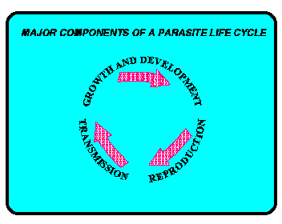

Slide 54
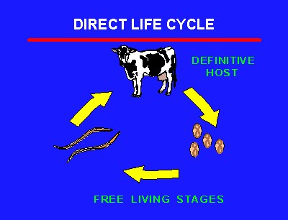
Simple or Direct Life Cycle (monoxenous)
only one host is required to complete its cycle
the parasite often spends most of its life, usually as an adult, and where it reproduces
Transmitted from one host to another through the air, by a fomite, or in contaminated food or water.

Slide 55
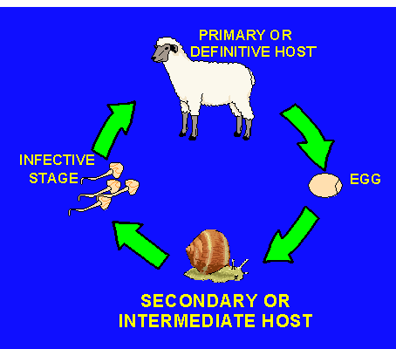
Indirect or heteroxenous life cycles
requires 2 or more hosts (a vector or intermediate host ) to reproduce or grow in
Frequently this may involve passing through a number of developmental stages & Evt.

Slide 56
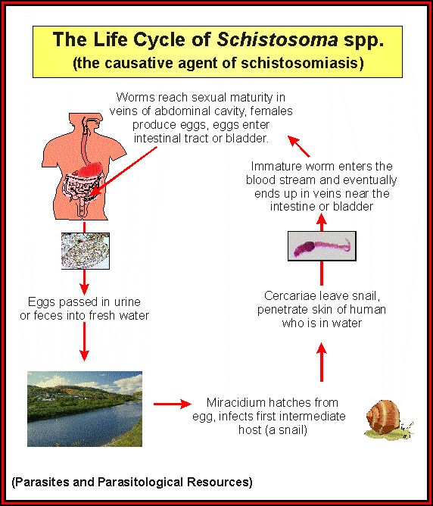
1.5.3. Why study life cycles?
  Control.
  Treatment.
  Epidemiology.
  Fundamental research.

Slide 57
1.6 Parasitic Infections & Disease:
Not all parasitic infections cause disease of clinical significance.
Both host and parasitic factors are involved for the parasitic infection to cause disease or not

Slide 58
1.6.1. Host Factors
Genetic factors, E.g. Black population who lack Duffy antigen resist P.vivax
Age,
Sex : e.g., T.vaginalis
Level of immunity: natural and acquired immunity
Nutrition (malnutrition or under nutrition)
Intensity and frequency of infections
Presence of co-existing disease or conditions, which reduces immune response. e.g. Pregnancy, HIV
Life style and occupation

Slide 59
1.6.2. Parasite factors
Strain of the parasite and adaptation to human host
Parasite load ( number of parasite )
Site (s) occupied in the body
Metabolic processes of the parasite, particularly the nature of any waste products or toxins produced by the parasite during its growth and reproduction..

Slide 60
1.6.3. How do Parasites Cause Inquiry to their Host?
Competition for the host’s nutrients
- Eg. D.latum absorbs vitamin B-12, can cause anemia
- other tapeworms absorb large amounts of proteins and sugars
Use of host’s fluids
- hookworm ingests blood, can be up to 250 ml/day
Destruction of host tissues
- some injure upon entry, some after established
- eg. Swimmers itch, cercariae penetrate and cause inflammation
- intestinal worms, after established cause small lesions in gut, possible secondary infection
- Entamoeba actively digest epithelial cells in large intestine

Slide 61
Tissue changes
  Cell and tissue parasites sometimes evoke changes in the growth pattern of the affected tissue.
  may cause serious consequences to host
  Tissue changes of parasitic origin are of four major types.
      Hyperplasia: Elevation of the metabolic rate of cells causes accelerated cell proliferation. Eg Fasciola
      Hypertrophy: An increase in cell or organ size
      Metaplasia, change of tissue cell type to another type. Eg. Paragonims (lung fluke)
      Neoplasia, growth of cell to form a new structure. Eg. Tumors

Slide 62
Toxins and secretions
- some may cause pathogenic response, some may inhibit immune function
- eg. Mosquito saliva
Mechanical interference
- Elephantiasis (filarial worms) blocks lymphatic system
- Tapeworms in large numbers can block intestine
- Plasmodium can cause RBC’s to stick together and clog capillaries

Slide 63
Host Immunity & Immuno – evasion of the parasite

Slide 64
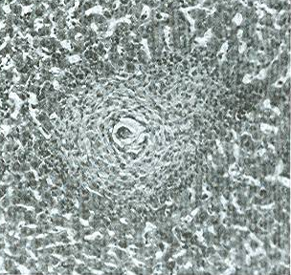
1.7.1. Host Responses
1.7. Host Immunity & Immuno – evasion of the parasite
Nonspecific immunity
  Macrophage endocytosis
    Common for bacteria and small protozoa
  Inflammation
    Acute – edema and increase of leukocytes
    Subacute – monocytes and lymphocytes present, with fibrocytes binding parasite with collagen.
    Chronic – plasma cells present and form a granuloma
  Hyperplasia – parasite causes host to produce more cells
    Liver fluke simulating enlargement of bile duct
  Neoplasia (cancer) – rare parasites have been associated with cancer, but mechanisms are still unknown.

Slide 65
Host Responses
Specific Immunity
Humeral response: Formation of antibodies or immunoglobulin s(Ig) by B cells.
  IgE fights helminths
  IgM and IgG important against protozoans
Cell mediated response: uses T-cells
  Cytotoxic T cells inject invading parasites
  Also release cytokines, which promote nonspecific immunity. (interconnected)

Slide 66
1.7.2. Parasite Responses
Antigenic variation
  Change surface glycoproteins regularly
Being poorly antigenetic
  Don’t induce a response, or a most a mild one
Hide within host cells
  Host can’t kill what it can’t find
Camouflage
  Use bits of host cells and attach to parasite’s surface
Depress host’s immune response
  Modulate produce of host T cell production

Slide 67
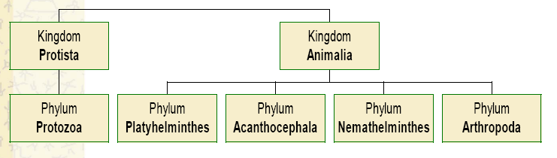
Taxonomy and nomenclature of parasites
Taxonomy

Slide 68
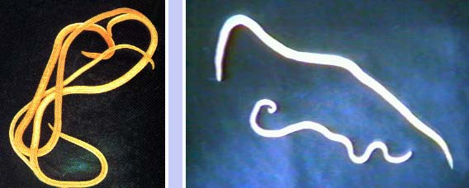
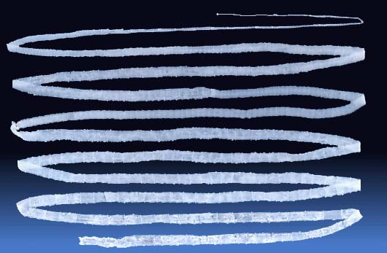
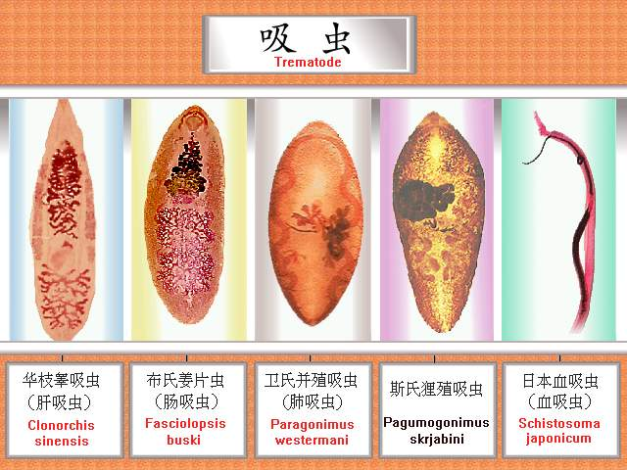
Taxonomic classification of helminths
Sub kingdom |  | Phylum |  | Class |  | Genus – examples
Metazoa |  | Nematodes Round worms; appear round in cross section, they have body cavities, a straight alimentary canal and an anus |  |  |  | Ascaris (roundworm) Trichuris (whipworm) Ancylostoma (hookworm) Necator (hookworm) Enterobius (pinworm or threadworm) Strongyloides
 |  | Platyhelminthes Flat worms; dorsoventrally flattened, no body cavity and, if present, the alimentary canal is blind ending |  | Cestodes Adult tapeworms are found in the intestine of their host They have a head (scolex) with sucking organs, a segmented body but no alimentary canal Each body segment is hermaphrodite |  | Taenia (tapeworm)
 |  |  |  | Trematodes Non-segmented, usually leaf-shaped, with two suckers but no distinct head They have an alimentary canal and are usually hermaphrodite and leaf shaped Schistosomes are the exception. They are thread-like, and have separate sexes |  | Fasciolopsis (liver fluke) Schistosoma (not leaf shaped!)

Slide 69
Taxonomic classification of protozoa
Sub kingdom |  | Phylum |  | Sub-phylum |  | Genus- examples |  | Species- examples
Protozoa |  | Sarcomastig-ophora further divided into |  | Sarcodina-- - move by pseudopodia |  | Entamoeba |  | E. histolytica
 |  |  |  | Mastigophora move by flagella |  | Giardia |  | G. lamblia
 |  | Apicomplexa no organelle of locomotion |  |  |  | Plasmodium |  | P. falciparum, P. vivax, P. malariae, P. ovale
 |  | Ciliophora move by cillia |  |  |  | Balantidium |  | B. coli
 |  | Microspora Spore-forming |  |  |  | Enterocyto-zoa |  | E. bienusi

Slide 70
Nomenclature of parasites
Common name vs scientific name
Parasites named by binomial nomenclature
  Genus (capitalized)
  Species (not capitalized)
Binomial name underlined or separately italicized
  Example: Ascaris lumbricoides, Ascaris lumbricoides

